Slide 1
Public databases and GWAS data
David H. Alexander

Slide 2
Overview
Bioinformatics resources on the web
Public repositories of genotype and GWAS datasets

Slide 3
Web bioinformatics tools
Suppose we performed our own study and found a SNP rs17696736 associated with our trait of interest (Type I diabetes)
Where is this SNP? Is it in/near a gene? If so, what is the gene product’s function?
Web tools can answer such questions without requiring knowledge of database structure, SQL language, etc.

Slide 4
dbSNP
SNPs (multiple organisms) discovered, submitted by researchers (www.ncbi.nlm.nih.gov/projects/SNP/)
Used recently in sequencing studies of rare Mendelian traits
dbVar is the database for structural variant types (inversions, translocations, CNV, etc.) (www.ncbi.nlm.nih.gov/dbvar/)
Build | Date | # Validated human SNPS
131 | 2010 | 12M
130 | 2009 | 6.5M
127 | 2007 | 5.7M

Slide 5
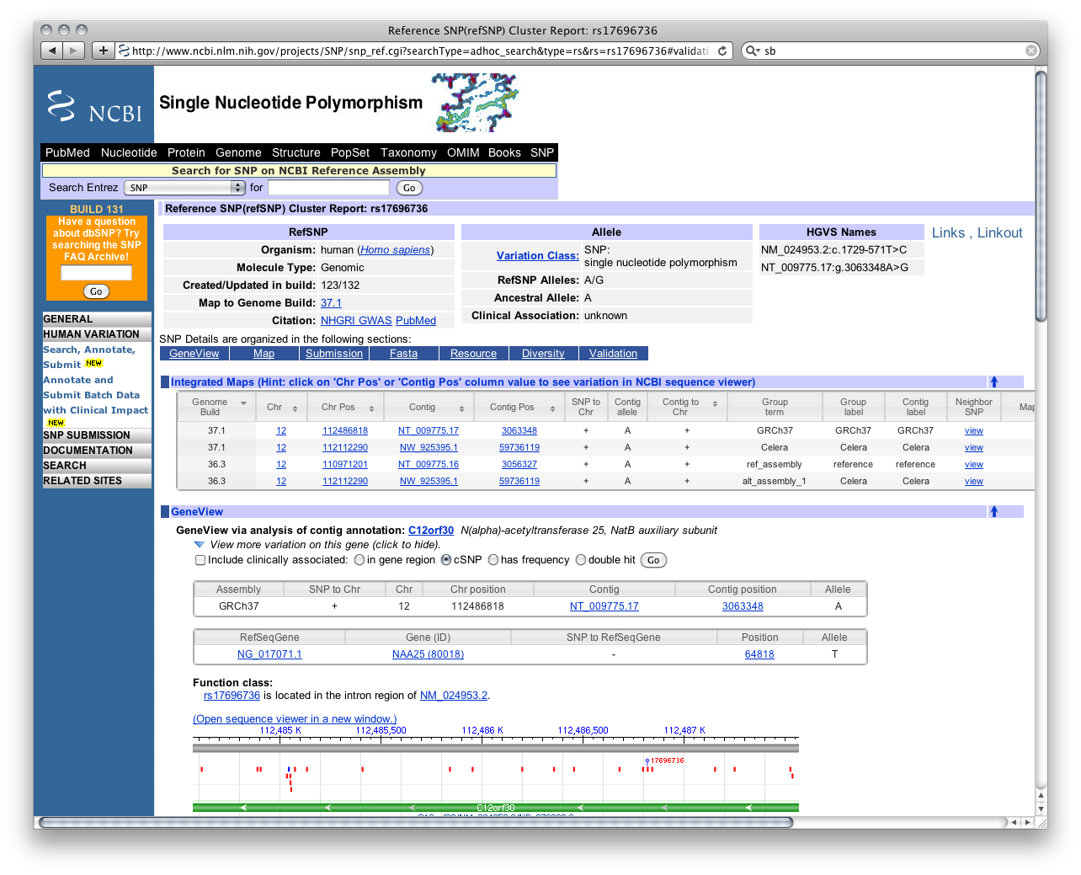

Slide 6
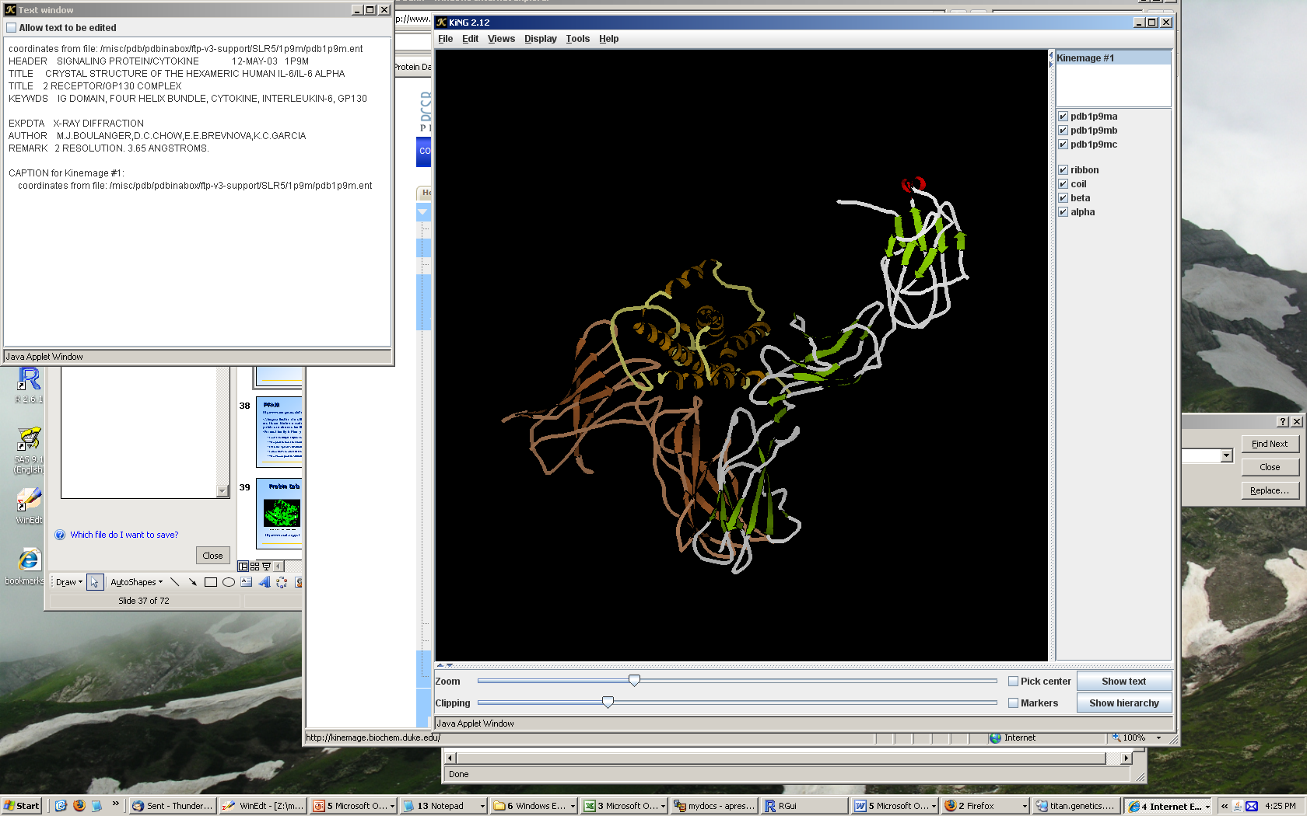
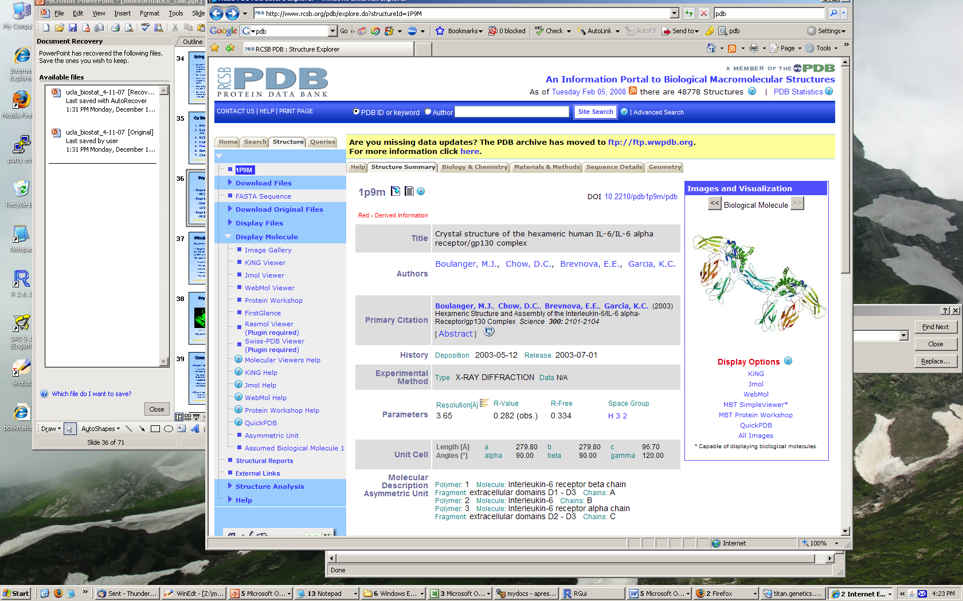
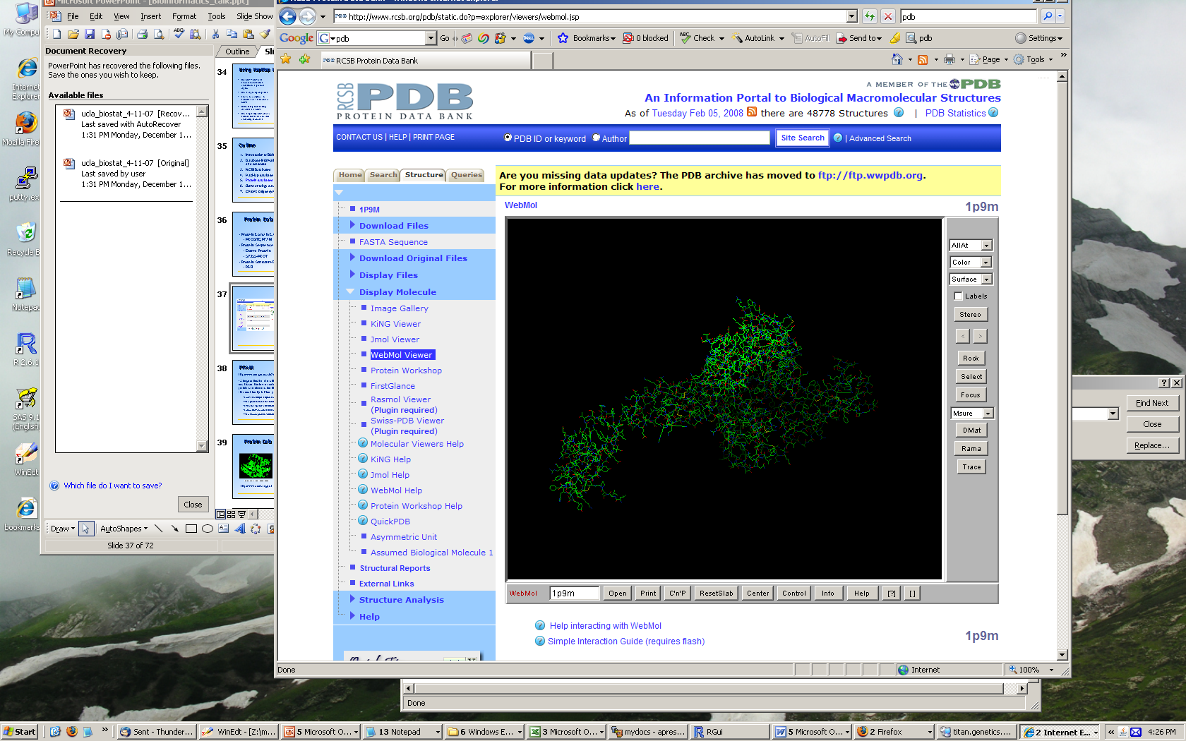
Protein Data Bank (www.pdb.org)
Protein database frontend with interactive visualization tools

Slide 7
UCSC Genome Browser
http://genome.ucsc.edu
Integrated presentation of genome data from many source databases (“tracks”)
Allows you to (easily) visualize the genomic landscape surrounding a genomic feature (a marker, a gene, a region, etc.)

Slide 8
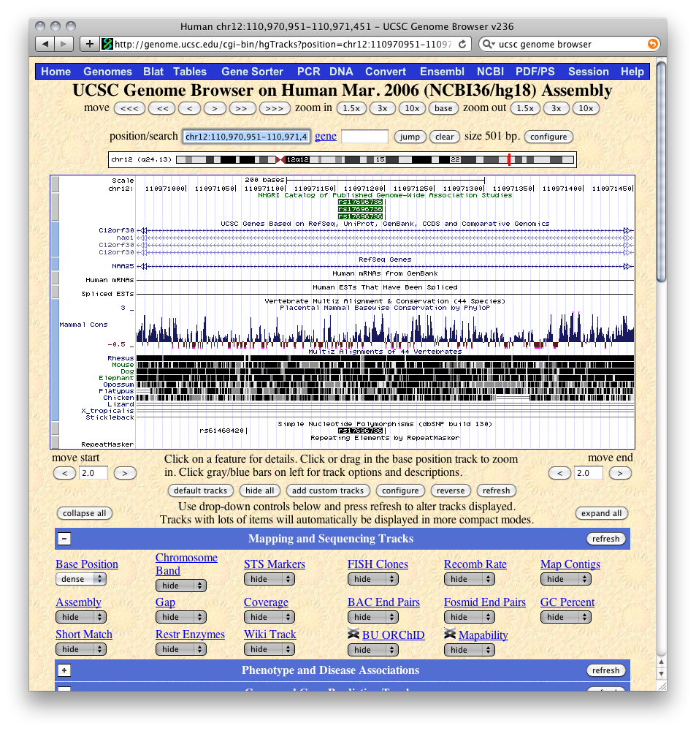

Slide 9
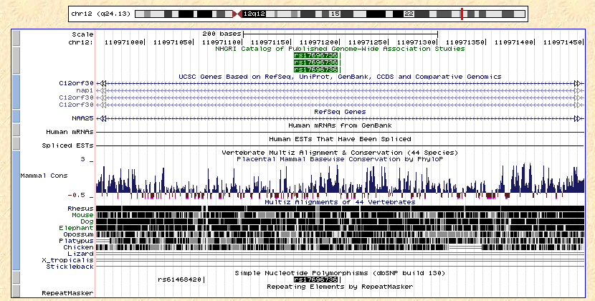

Slide 10
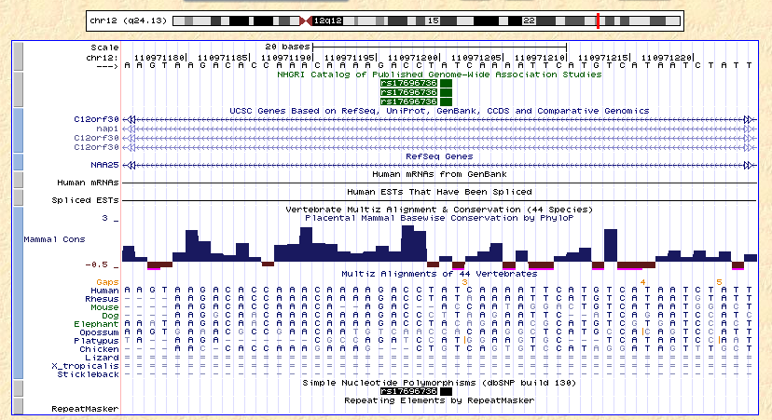

Slide 11
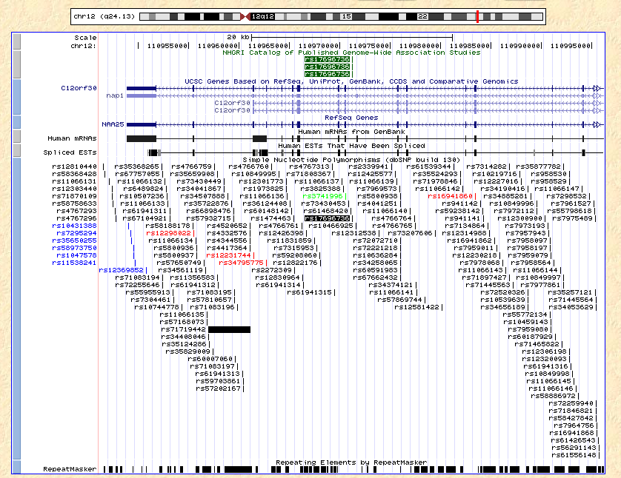

Slide 12
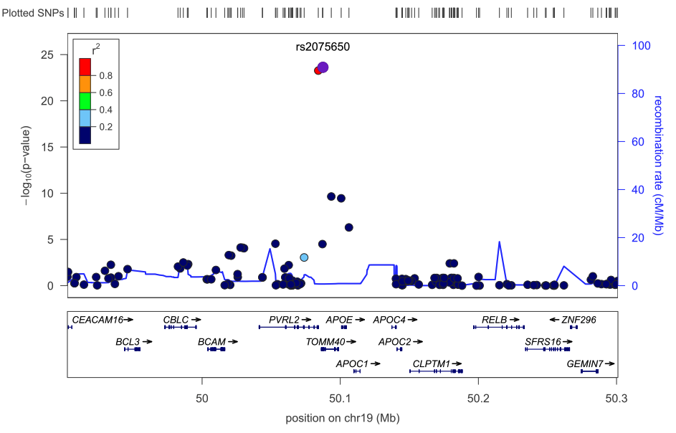
How to make custom genome browser style plots
“Human genome graphs” link from UCSC site
SNAP (http://www.broadinstitute.org/mpg/snap/)
LocusZoom (http://csg.sph.umich.edu/locuszoom/)
Figure credit: gettinggeneticsdone.blogspot.com

Slide 13
Disease phenotype databases
Collect information about diseases and their known associations with genetic variants
Can be manually curated (OMIM) or automatically culled from the literature (NHGRI GWAS catalog)

Slide 14
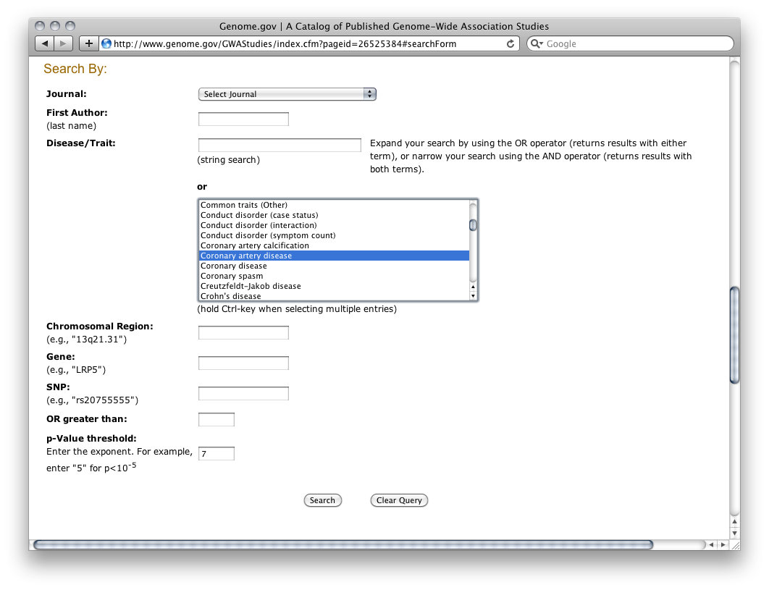
NHGRI GWAS catalog
http://www.genome.gov/GWAStudies/

Slide 15
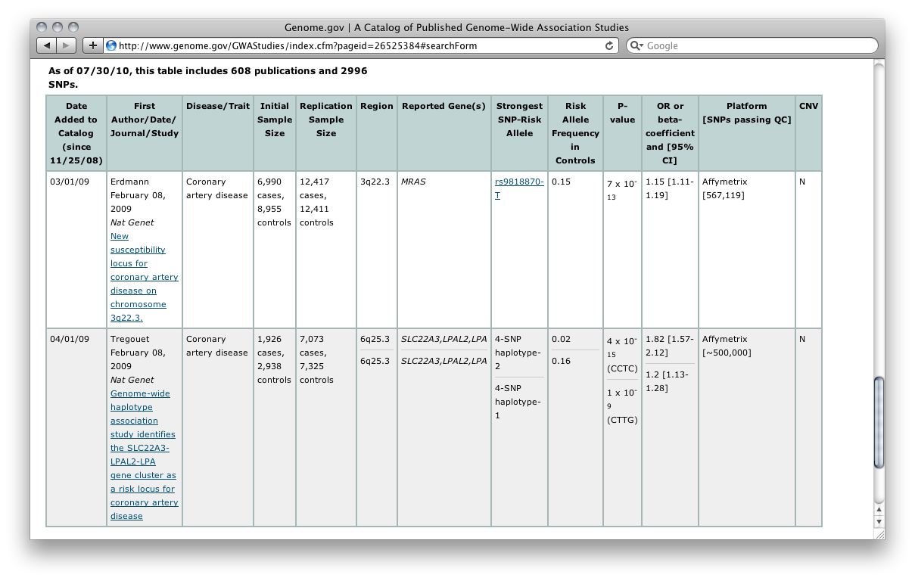

Slide 16
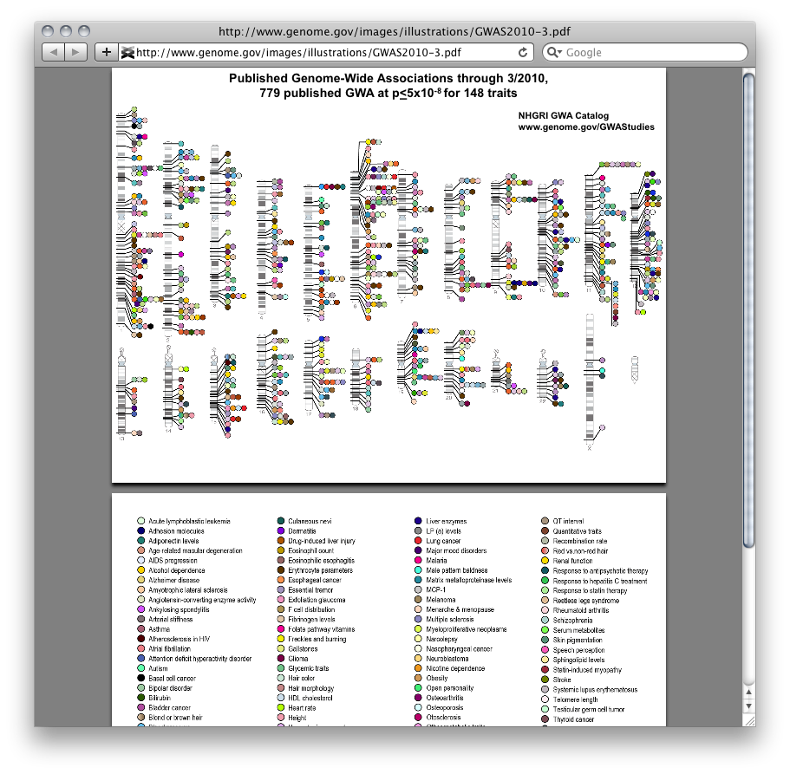

Slide 17
Gene ontology (GO)
Three components
Biological Process
A biological objective to which the gene or gene product contributes (one or more assemblies of molecular functions)
“cell growth and maintenance”, “signal transduction” (high-level: broad) vs. “translation”, “cAMP biosynthesis” (low-level: narrow)
Molecular Function
The biological activity (including specific binding to ligands or structures) of a gene product
Broad functional terms: enzyme, transporter, ligand
Narrower functional terms: adenylate cyclase
Cellular Components
The location in the cell where a gene product is active
“ribosome”, “proteosome”, “Golgi apparatus”

Slide 18
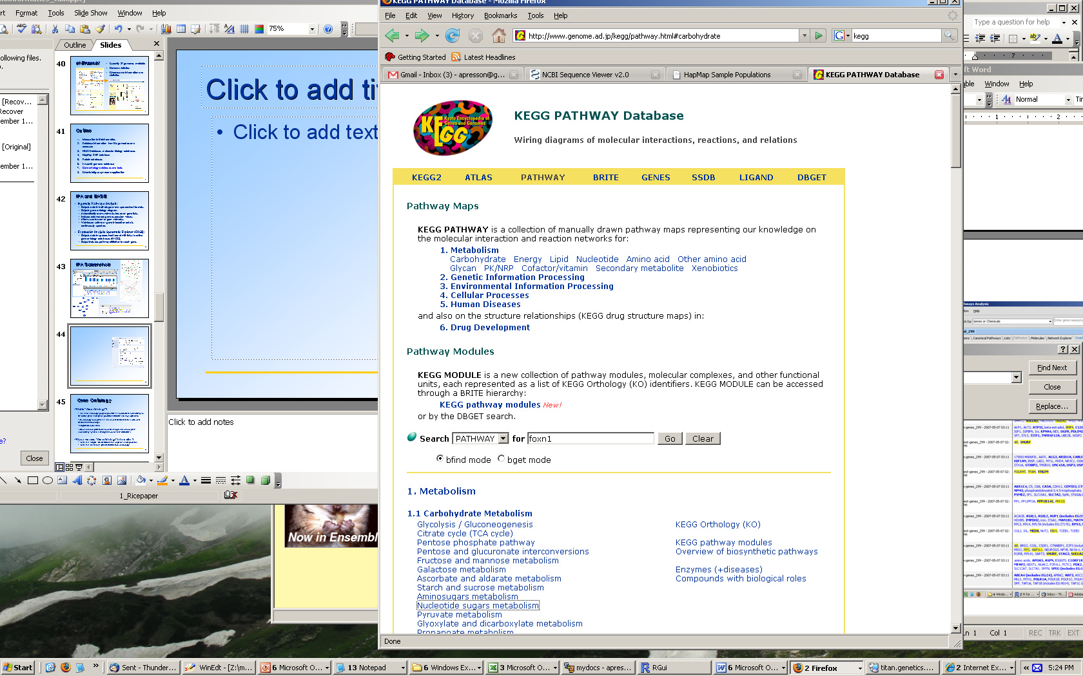
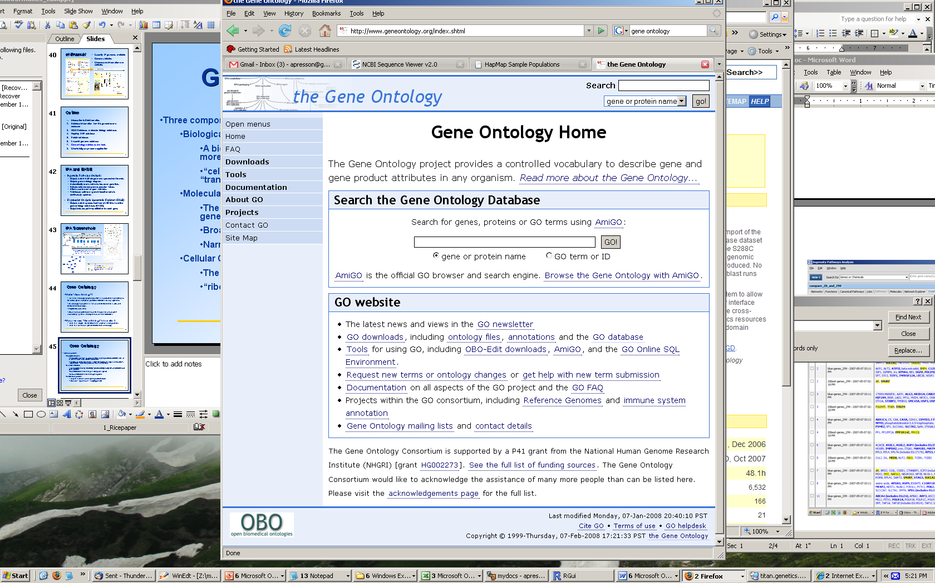
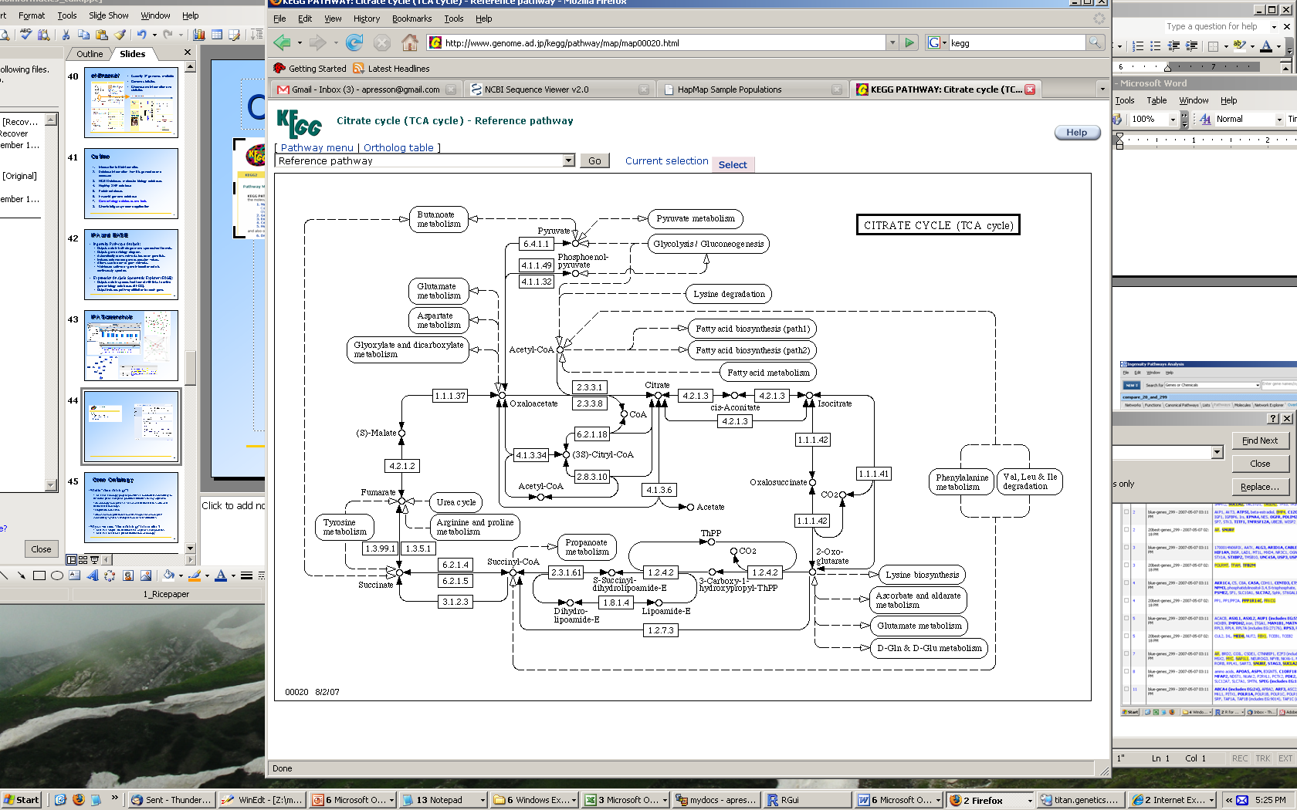
Gene Ontology Databases
Gene ontology = study of molecular interactions and biological pathways.
GO database – query pathway annotations for a gene (also available at Entrez Gene)
KEGG database – query manually drawn pathways

Slide 19
Public genotype datasets
A large number of GWA studies available through the NIH’s dbGAP program
The Hapmap datasets are publically available

Slide 20
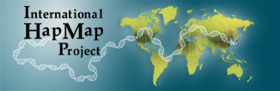
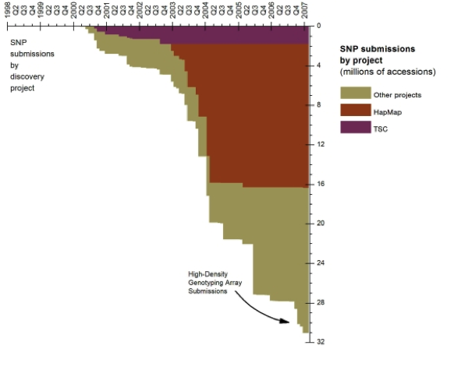
Hapmap project
Project launched 2002, goal: to assay haplotypes in several major populations in order to understand patterns of variation and linkage disequilibrium
By understanding LD, hoped to be able to devise efficient SNP tagging arrays for GWA studies
Major contributor to dbSNP early on
www.hapmap.org

Slide 21
Hapmap project
Phase I (2005)
1M SNPs typed in samples:
30 CEU trios (“European”)
30 YRI trios (Yoruba--Nigeria)
45 JPT unrelated (Tokyo)
45 CHB unrelated (Beijing)
Phase II (2007)
Increased SNP density (3.1M SNPs typed)
Phase III (2009)
Expanded coverage to 11 worldwide populations, including several admixed groups
1.5M SNP markers

Slide 22
Hapmap resources
Summary statistics and bulk downloads available
Raw data may be useful as population references
for imputation or phasing
for designing appropriate genotyping arrays for populations not yet well studied
Summary statistics are integrated into dbSNP, UCSC browser

Slide 23
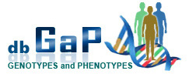

GWA study repositories
dbGAP (NIH) http://www.ncbi.nlm.nih.gov/gap
EGA (Europe) http://www.ebi.ac.uk/ega/page.php

Slide 24
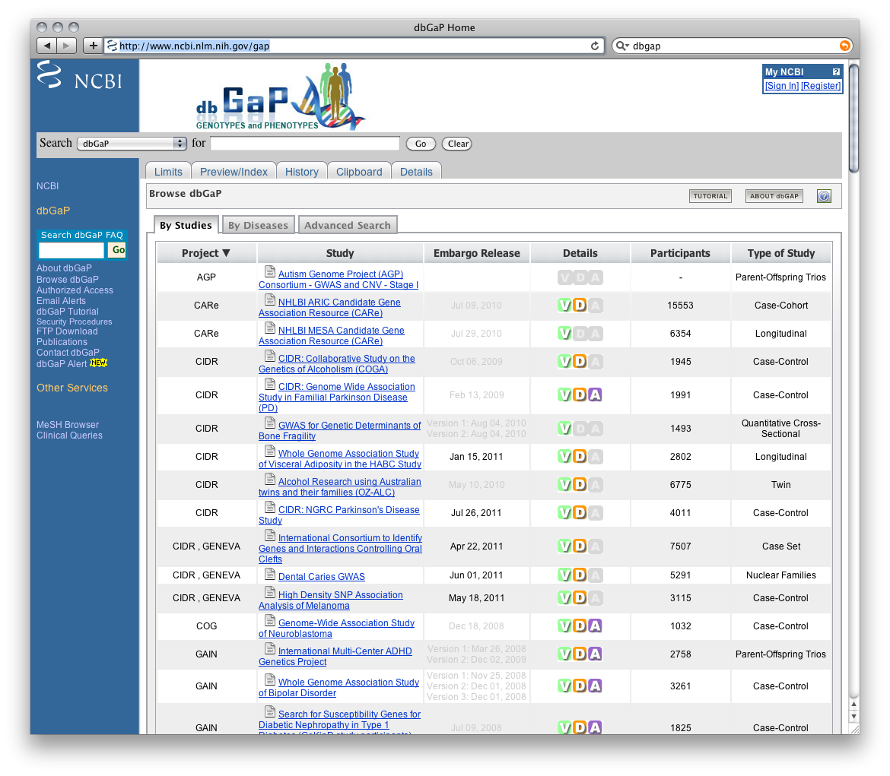

Slide 25
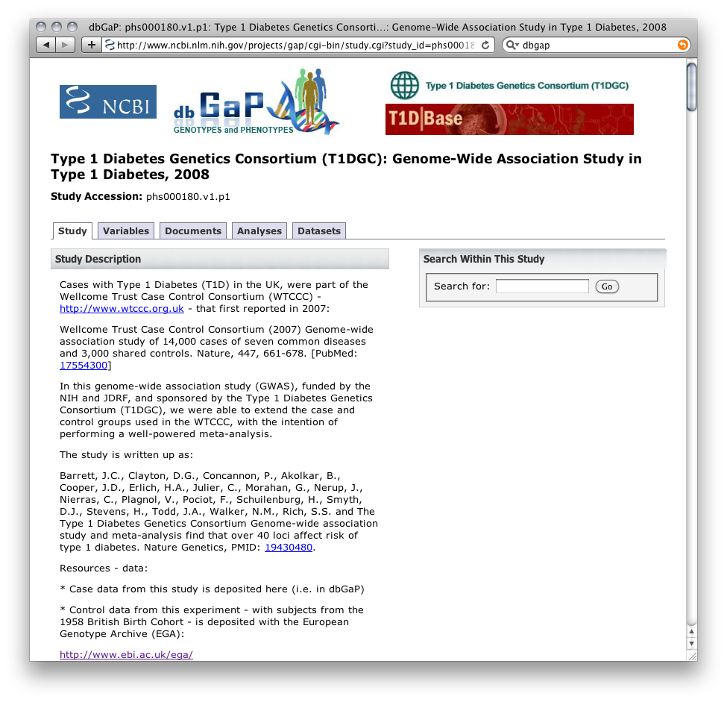

Slide 26
